Slide 1
Traditional Methods for Machine Learning in Graphs
1

Slide 2















Graph Properties
Degree: how many friends do I have?
Weights: how strong are the ties?
Path: how far am I from another vertex?
Connectivity: can I reach all other vertices?
Diameter: how dense are they?
Centrality (e.g., betweenness, closeness): Am I in the center of everyone?
2

Slide 3
Graph Analysis Problem
Existing Graph Analysis Problems
Clique identification
Shortest path
K-core decomposition
and more…
3

Slide 4
We need machine learning for graphs
Many Applications
Challenge:
finding a way to represent, or encode, graph structure so that it can be easily exploited by machine learning models.
Traditionally, machine learning approaches relied on user-defined heuristics to extract features encoding structural information about a graph (e.g., degree statistics or kernel functions).
4

Slide 5
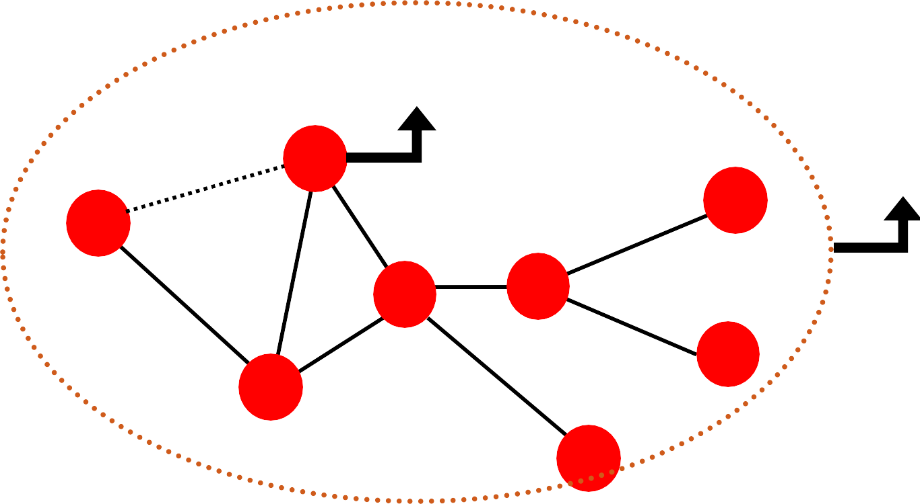
Machine Learning Tasks on Graphs
Node-level prediction
Link-level prediction
Graph-level prediction
?
Node-level ?
Link-level
B
Graph-level
F
?
A
D
E
G
C
H
5

Slide 6
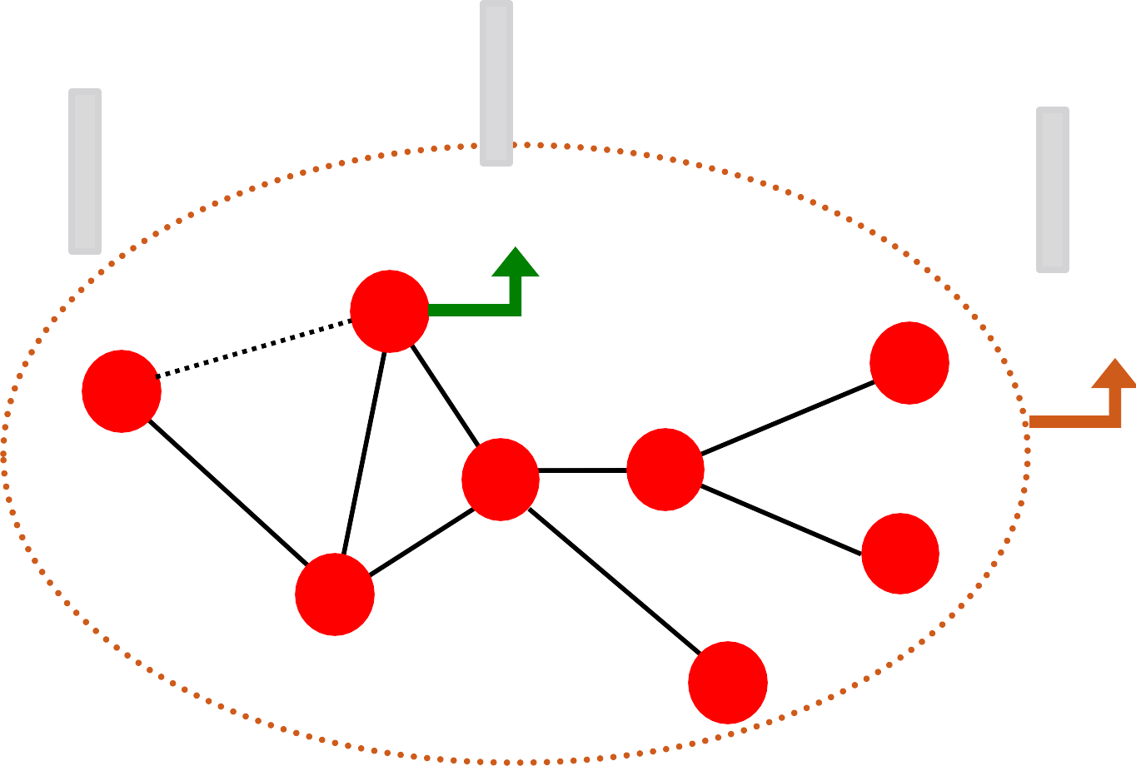
Traditional ML Pipeline
Design features for nodes/links/graphs
Obtain features for all training data
∈ ℝ^{𝐷}
∈ ℝ^{𝐷}
∈ ℝ^{𝐷}
Node features
B
Link features
A
Graph features
F
D
E
G
C
H
6

Slide 7
Traditional ML Pipeline
Train an ML model:
Random forest
SVM
Neural network, etc.
𝒙_{𝟏} 𝑦₁
Test the model:
Given a new node/link/graph, obtain its features and make a prediction
𝒙 𝑦
𝒙_{𝑵}
𝑦_{𝑁}
7

Slide 8
Feature Design
Using effective features over graphs is the key to achieving good model performance.
Traditional ML pipeline uses hand-designed features.
In this lecture, we overview the traditional
features for:
Node-level prediction
Link-level prediction
Graph-level prediction
For simplicity, we focus on undirected graphs.
8

Slide 9
Goal: Make predictions for a set of objects
ML in Graphs
Design choices:
Features: d-dimensional vectors
Objects: Nodes, edges, sets of nodes, entire graphs
Objective function: What task are we aiming to solve?
9

Slide 10


Example: Node-level prediction
ML in Graphs
Given:
Learn a function:
How do we learn the function?
10

Slide 11
Node-level Tasks and Features
11

Slide 12

Node-level Tasks
?
?
?
?
Machine Learning
?
Node classification!
ML needs features.
12

Slide 13
Node-level Features: Overview
Goal: Characterize the structure and position of a node in the network:
Node degree
Node centrality
Clustering coefficient
Graphlets
A
Node feature?
B
F
D
E
G
C
H
13

Slide 14
Node-level Features: Node Degree
The degree 𝑘_{𝑣} of node 𝑣 is the number of edges (neighboring nodes) the node has.
Treats all neighboring nodes equally.
𝑘_{𝐵} = 2
𝑘_{𝐴} = 1
A
B
𝑘_{𝐷} = 4
F
D
E
G
C
𝑘_{𝐶} = 3
H
14

Slide 15
Node-level Features: Node Centrality
Node degree counts the neighboring nodes without capturing their importance.
Node centrality 𝑐_{𝑣} takes the node importance in a graph into account
Different ways to model importance:
Eigenvector centrality
Betweenness centrality
Closeness centrality
many others…
Engienvector centrality
15

Slide 16





Node Centrality (1)
Eigenvector centrality:
A node 𝑣 is important if surrounded by important neighboring nodes 𝑢 ∈ 𝑁(𝑣).
We model the centrality of node 𝑣 as the sum of the centrality of neighboring nodes:
𝜆 is normalization constant (it will turn out to be the largest eigenvalue of A)
Notice that the above equation models centrality in a recursive manner. How do we solve it?
16

Slide 17




Node Centrality (1)
Eigenvector centrality:
Rewrite the recursive equation in the matrix_{B} form.
𝜆𝒄 = 𝑨𝒄
𝑨: Adjacency matrix
𝑨_{𝑢𝑣}= 1 if 𝑢 ∈ 𝑁(𝑣)
𝒄: Centrality vector
𝜆: Eigenvalue
𝜆 is normalization const (largest eigenvalue of A)
We see that centrality 𝑐 is the eigenvector of 𝑨!
The largest eigenvalue 𝜆_{𝑚𝑎𝑥} is always positive and unique (by Perron-Frobenius Theorem).
The eigenvector 𝒄_{𝑚𝑎𝑥} corresponding to 𝜆_{𝑚𝑎𝑥} is used for centrality.
17

Slide 18






Node Centrality (2)
Betweenness centrality:
A node is important if it lies on many shortest paths between other nodes.
Example:
𝑐_{𝐴} = 𝑐_{𝐵} = 𝑐_{𝐸} = 0
𝑐_{𝐶} = 3
(A-C-B, A-C-D, A-C-D-E)
B
A
D
E
𝑐_{𝐷} = 3
(A-C-D-E, B-D-E, C-D-E)
C
18

Slide 19




Node Centrality (3)
Closeness centrality:
A node is important if it has small shortest path lengths to all other nodes.
Example:
B
𝑐_{𝐴} = 1/(2 + 1 + 2 + 3) = 1/8
(A-C-B, A-C, A-C-D, A-C-D-E)
A
D
E
𝑐 = 1/(2 + 1 + 1 + 1) = 1/5
𝐷
(D-C-A, D-B, D-C, D-E)
C
19

Slide 20






Node Features: Clustering Coefficient
Measures how connected 𝑣′𝑠 neighboring nodes are:
#(node pairs among 𝑘_{𝑣} neighboring nodes)
In our examples below the denominator is 6 (4 choose 2).
Examples:
𝑣
𝑣
𝑣
𝑒_{𝑣} = 1
𝑒_{𝑣} = 0.5
𝑒_{𝑣} = 0
20

Slide 21
Node Features: Graphlets
Observation: Clustering coefficient counts the #(triangles) in the ego-network
𝑣
𝑣
𝑣
𝑣
𝑒_{𝑣} = 0.5
3 triangles (out of 6 node triplets)
We can generalize the above by counting #(pre-specified subgraphs, i.e., graphlets).
21

Slide 22
Node Features: Graphlets
Goal: Describe network structure around node 𝑢
Graphlets are small subgraphs that describe the structure of node 𝑢’s network neighborhood
Analogy:
Degree counts #(edges) that a node touches
Clustering coefficient counts #(triangles) that a node touches.
Graphlet Degree Vector (GDV): Graphlet-base features for nodes
GDV counts #(graphlets) that a node touches
22

Slide 23

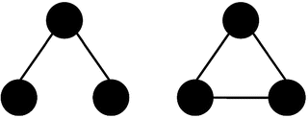


Node Features: Graphlets
Considering graphlets of size 2-5 nodes we get:
Vector of 73 coordinates is a signature of a node that describes the topology of node's neighborhood
Graphlet degree vector provides a measure of a node’s local network topology:
Comparing vectors of two nodes provides a more detailed measure of local topological similarity than node degrees or clustering coefficient.
B
A
𝑢
E
C
23

Slide 24
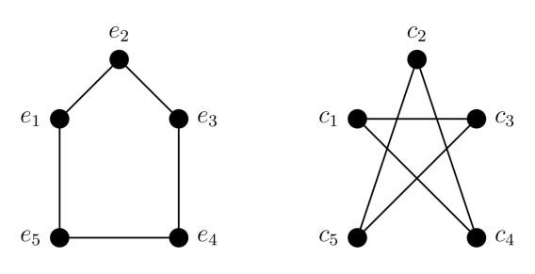
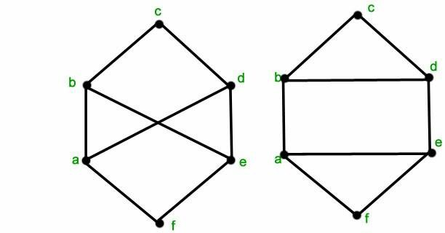
Isomorphism
Def: Graph Isomorphism
Two graphs which contain the same number of nodes connected in the same way are said to be isomorphic.
Isomorphic
Node mapping: (e2,c2), (e1, c5),
(e3,c4), (e5,c3), (e4,c1)
Non-Isomorphic
The right graph has cycles of length 3 but he left graph does not, so the graphs cannot be isomorphic.
24

Slide 25




Induced Subgraph
Def: Induced subgraph
A graph, formed from a subset of vertices and all of the edges connecting the vertices in that subset.
B
A
𝑢
E
C
B
B
Induced subgraph:
Non-induced
Subgraph:
𝑢
𝑢
C
C
25

Slide 26
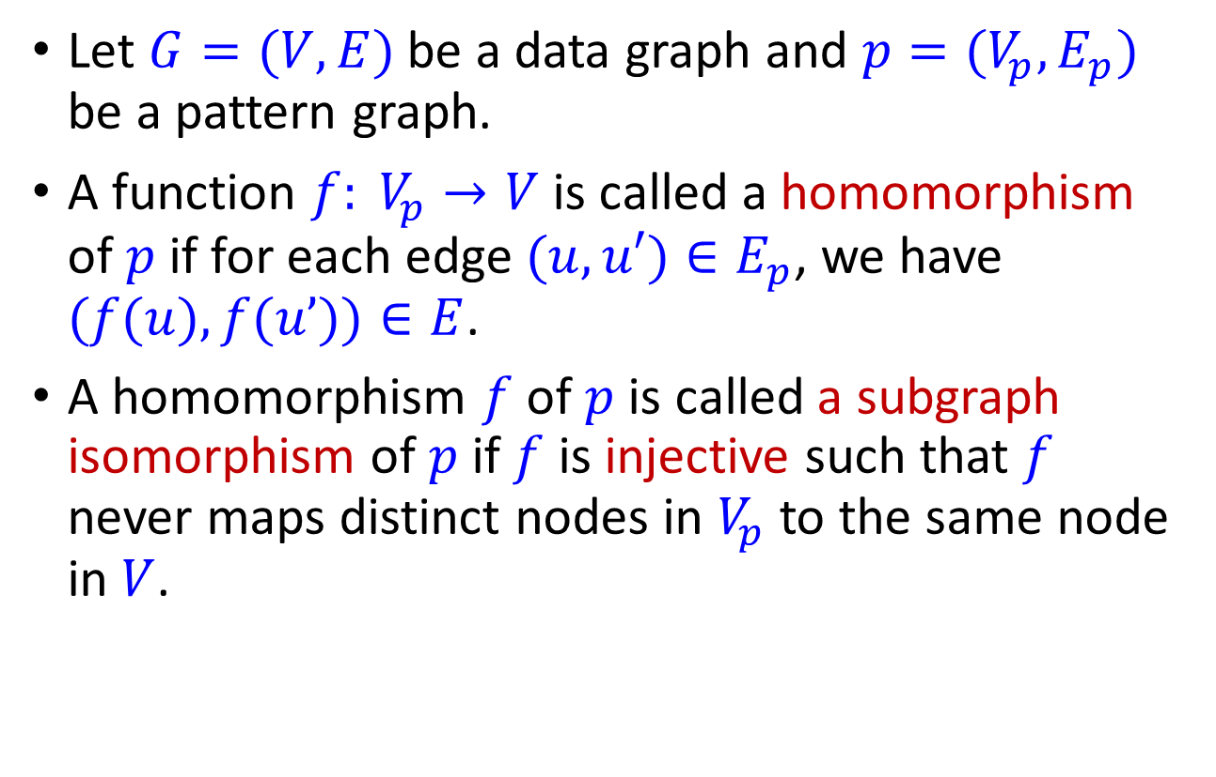
Subgraph Isomorphism
Let $G=(V, E)$ be a data graph and $p=(V_{p},E_{p})$ be a pattern graph.
A function $f: V_{p}→V$ is called a homomorphism of $p$ if for each edge $(u, u′)∈E_{p}$, we have $(f(u), f(u’))∈E$.
A homomorphism $f$ of $p$ is called a subgraph isomorphism of $p$ if $f$ is injective such that $f$ never maps distinct nodes in $V_{p}$ to the same node in $V$.
26

Slide 27



An Example
A
D
Let $G=(V, E)$ be a data graph and $p=(V_{p},E_{p})$ be a pattern graph.
B
C
Pattern $p$
1
4
5
2
3
6
Data Graph $G$
27

Slide 28


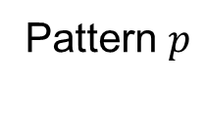
Homorphism
A function $f: V_{p}→V$ is called a homomorphism of $p$ if for each edge $(u, u′)∈E_{p}$, we have $(f(u), f(u’))∈E$.
A
D
B
C
Pattern $p$
1
4
5
2
3
6
Data Graph $G$
28

Slide 29
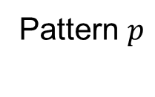
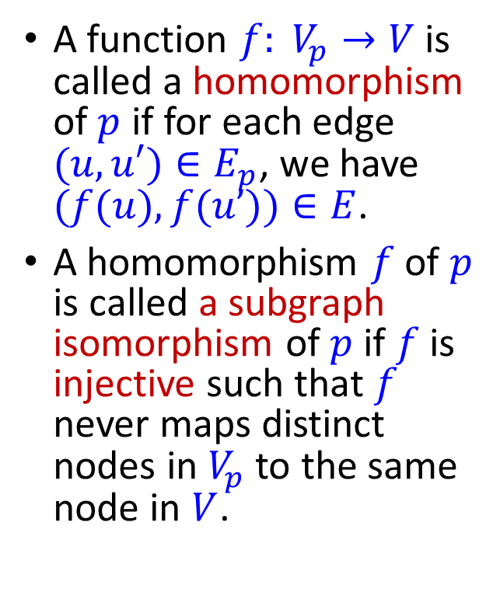

Subgraph Isomorphism
A function $f: V_{p}→V$ is called a homomorphism of $p$ if for each edge $(u, u′)∈E_{p}$, we have $(f(u), f(u’))∈E$.
A homomorphism $f$ of $p$ is called a subgraph isomorphism of $p$ if $f$ is injective such that $f$ never maps distinct nodes in $V_{p}$ to the same node in $V$.
A
D
B
C
Pattern $p$
1
4
5
2
3
6
Data Graph $G$
29

Slide 30
Subgraph Isomorphism (Non-Induced)
A function $f: V_{p}→V$ is called a homomorphism of $p$ if for each edge $(u, u′)∈E_{p}$, we have $(f(u), f(u’))∈E$.
A homomorphism $f$ of $p$ is called a subgraph isomorphism of $p$ if $f$ is injective such that $f$ never maps distinct nodes in $V_{p}$ to the same node in $V$.
A
D
B
C
Pattern $p$
1
4
5
2
3
6
Data Graph $G$
30

Slide 31
Subgraph Isomorphism (Non-Induced)
A function $f: V_{p}→V$ is called a homomorphism of $p$ if for each edge $(u, u′)∈E_{p}$, we have $(f(u), f(u’))∈E$.
A homomorphism $f$ of $p$ is called a subgraph isomorphism of $p$ if $f$ is injective such that $f$ never maps distinct nodes in $V_{p}$ to the same node in $V$.
A
D
B
C
Pattern $p$
1
4
5
2
3
6
Data Graph $G$
31

Slide 32


Subgraph Isomorphism (Induced)
A function $f: V_{p}→V$ is called a homomorphism of $p$ if for each edge $(u, u′)∈E_{p}$, we have $(f(u), f(u’))∈E$.
A homomorphism $f$ of $p$ is called a subgraph isomorphism of $p$ if $f$ is injective such that $f$ never maps distinct nodes in $V_{p}$ to the same node in $V$.
A
D
B
C
Pattern $p$
1
4
5
2
3
6
Data Graph $G$
32

Slide 33
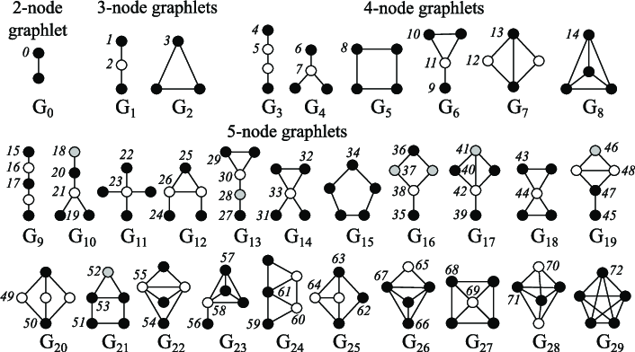
Graphlets: Rooted connected induced non-isomorphic subgraphs:
Przulj et al., Bioinformatics 2004
Node Features: Graphlets
B
A
𝑢
E
C
𝑢 has graphlets: 0, 1, 2, 3, 5,
10, 11, …
Take some nodes and all the edges between them.
Graphlet id (Root of node 𝑢)
There are 73 different graphlet of up to 5 nodes
33

Slide 34
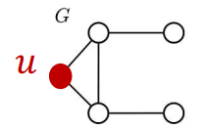
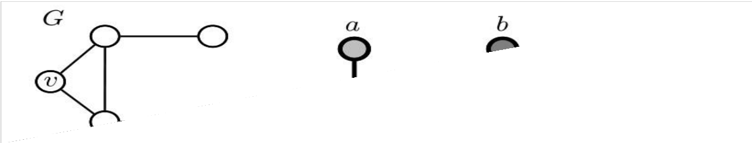
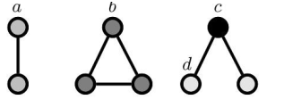

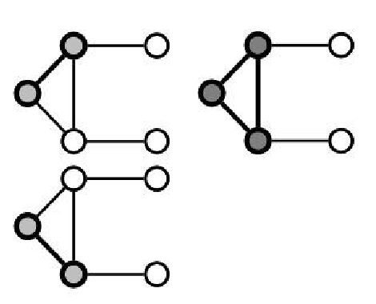
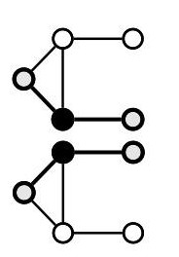
Node Features: Graphlets
Graphlet Degree Vector (GDV): A count vector of graphlets rooted at a given node.
Example:
Possible graphlets up to size 3
𝑢
Graphlet instances of node u:
𝑎 𝑐
𝑏 𝑑
GDV of node 𝑢:
𝑎, 𝑏, 𝑐, 𝑑
[2,1,0,2]
34

Slide 35
Node-level Feature: Summary
We have introduced different ways to obtain node features.
They can be categorized as:
Importance-based features:
Node degree
Different node centrality measures
Structure-based features:
Node degree
Clustering coefficient
Graphlet count vector
35

Slide 36
Node-level Feature: Summary
Importance-based features: capture the importance of a node in a graph
Node degree:
Simply counts the number of neighboring nodes
Node centrality:
Models importance of neighboring nodes in a graph
Different modeling choices: eigenvector centrality, betweenness centrality, closeness centrality
Useful for predicting influential nodes in a graph
Example: predicting celebrity users in a social network
36

Slide 37
Node-level Feature: Summary
Structure-based features: Capture topological properties of local neighborhood around a node.
Node degree:
Counts the number of neighboring nodes
Clustering coefficient:
Measures how connected neighboring nodes are
Graphlet degree vector:
Counts the occurrences of different graphlets
Useful for predicting a particular role a node plays in a graph:
Example: Predicting protein functionality in a protein-protein interaction network.
37

Slide 38
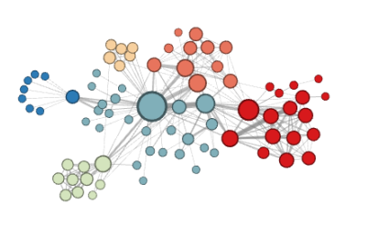
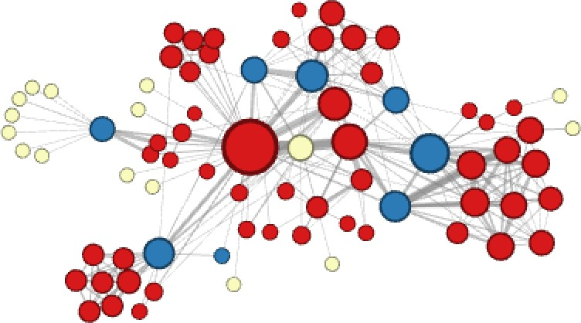
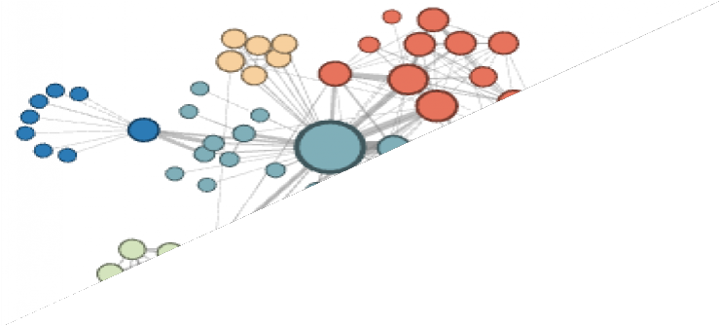
Different ways to label nodes of the network:
Discussion
Node features defined so far would allow to distinguish nodes in the above example
However, the features defines so far would not allow for distinguishing the above node labelling
38

Slide 39
Link Prediction Task and Features
39

Slide 40

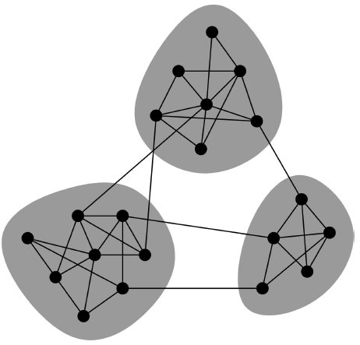
When can people be friends?
In 1960s, Mark Granovetter interviewed people who had recently changed employers to learn how they discovered their new jobs.
Surprising: Acquaintances rather than close friends help to find a new job.
Triadic Closure: If two people in a social network have a friend in common, then there is an increased likelihood that they will become friends themselves at some point in future.
Refer to Networks Crowds and Markets by D Easley and J. Kleinberg, and Jure Leskovec’s lecture notes.
40

Slide 41
Link-level Prediction Task: Recap
The task is to predict new links based on the existing links.
At test time, node pairs (with no existing links) are ranked, and top 𝐾 node pairs are predicted.
The key is to design features for a pair of nodes.
?
B
F
A
D
E
G
C
?
H
41

Slide 42


















Two formulations of the link prediction task:
Link-level Prediction as a Task
1) Links missing at random:
Remove a random set of links and then aim to predict them
2) Links over time:
Given 𝐺[𝑡₀, 𝑡′ ] a graph defined by edges
0
up to time 𝑡′ , output a ranked list L
0
′
of edges (not in 𝐺[𝑡₀, 𝑡₀]) that are
predicted to appear in time 𝐺[𝑡 , 𝑡′ ]
1 1
𝐺[𝑡₀, 𝑡′ ]
0
𝐺[𝑡₁, 𝑡′ ]
1
1
42

Slide 43

















Link Prediction via Proximity
Methodology:
For each pair of nodes (x,y) compute score c(x,y)
For example, c(x,y) could be the # of common neighbors of x and y
Sort pairs (x,y) by the decreasing score c(x,y)
Predict top n pairs as new links
See which of these links actually
appear in 𝐺[𝑡 , 𝑡′ ]
X
1 1
43

Slide 44
Link-level Features: Overview
Distance-based feature
Local neighborhood overlap
Global neighborhood overlap
Link feature
B
A
F
D
E
G
C
H
44

Slide 45
Shortest-path distance between two nodes
Distance-based Features
Example:
B
F
𝑆_{𝐵𝐻} = 𝑆_{𝐵𝐸} = 𝑆_{𝐴𝐵} = 2
A
D
E
𝑆_{𝐵𝐺} = 𝑆_{𝐵𝐹} = 3
G
C
H
However, this does not capture the degree of
neighborhood overlap:
Node pair (B, H) has 2 shared neighboring nodes, while pairs (B, E) and (A, B) only have 1 such node.
45

Slide 46
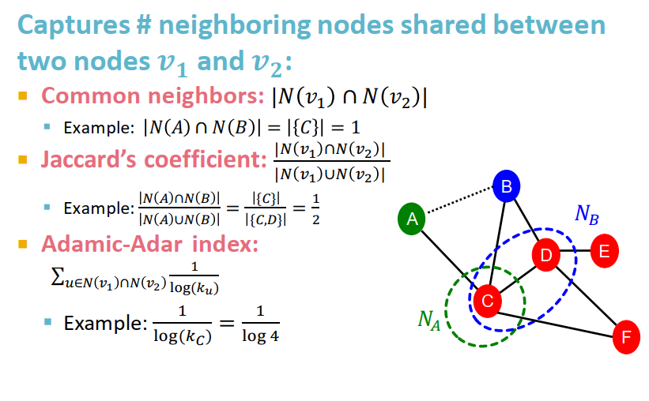

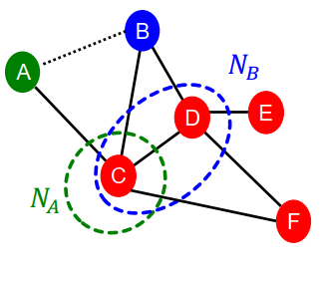
Captures # neighboring nodes shared between two nodes 𝒗_{𝟏} and 𝒗_{𝟐}:
Local Neighborhood Overlap
Common neighbors: |𝑁 𝑣₁ ∩ 𝑁 𝑣₂ |
Example: 𝑁 𝐴 ∩ 𝑁 𝐵 = 𝐶 = 1
Jaccard’s coefficient: ^{|𝑁 𝑣1 ∩𝑁 𝑣2}
|
|𝑁 𝑣₁ ∪𝑁 𝑣₂ |
_{Example:} 𝑁 𝐴 ∩𝑁 𝐵 ₌ {𝐶} ₌ 1
B
𝑁
𝑁 𝐴 ∪𝑁 𝐵 {𝐶,𝐷} 2
A
𝐵
Adamic-Adar index:
1
D
E
σ
𝑢∈𝑁 𝑣₁ ∩𝑁 𝑣₂
log(𝑘_{𝑢})
C
Example: ¹ = ¹
log(𝑘_{𝐶}) log 4
𝑁
𝐴
F
46

Slide 47
Global Neighborhood Overlap
Limitation of local neighborhood features:
Metric is always zero if the two nodes do not have any neighbors in common.
B
𝑁
A
𝐸
D
E
𝑁_{𝐴} ∩ 𝑁_{𝐸} = 𝜙
|𝑁_{𝐴} ∩ 𝑁_{𝐸} | = 0
C
𝑁_{𝐴}
F
However, the two nodes may still potentially be connected in the future.
Global neighborhood overlap metrics resolve the limitation by considering the entire graph.
47

Slide 48
Global Neighborhood Overlap
Katz index: count the number of walks of all lengths between a given pair of nodes.
Q: How to compute #walks between two nodes?
Use powers of the graph adjacency matrix!
48

Slide 49

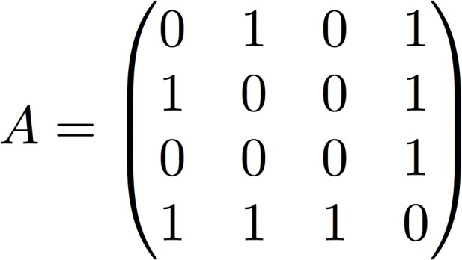


Intuition: Powers of Adj Matrices
Computing #walks between two nodes
Recall: 𝑨_{𝑢𝑣} = 1 if 𝑢 ∈ 𝑁(𝑣)
Let 𝑷^{(𝑲)} = #walks of length 𝑲 between 𝒖 and 𝒗
𝒖𝒗
We will show 𝑷^{(𝑲)} = 𝑨^{𝒌}
𝑷^{(𝟏)} = #walks of length 1 (direct neighborhood)
𝒖𝒗
between 𝑢 and 𝑣 = 𝑨_{𝒖𝒗}
_{𝑷}(𝟏) _{= 𝑨𝟏𝟐}
𝟏𝟐
4
3
2
1
49

Slide 50
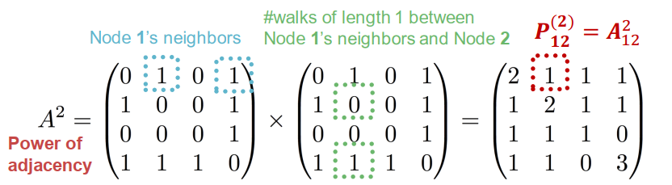
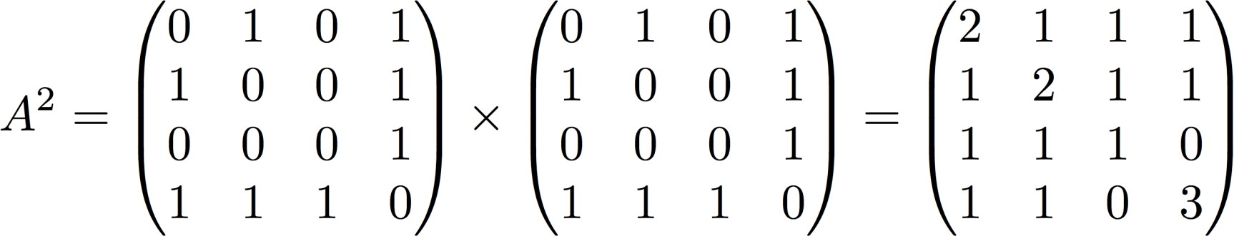
Intuition: Powers of Adj Matrices
How to compute ?
Step 1: Compute #walks of length 1 between each of 𝒖’s neighbor and 𝒗
Step 2: Sum up these #walks across u’s neighbors
𝑷^{(𝟐)} = Σ 𝑨_{𝒖𝒊} ∗ 𝑷^{(𝟏)} = Σ 𝑨_{𝒖𝒊} ∗ 𝑨_{𝒊𝒗} = 𝑨^{𝟐}
𝒖𝒗 𝒊
𝒊𝒗
𝒊 𝒖𝒗
#walks of length 1 between Node 1’s neighbors and Node 2
_{𝑷}(𝟐) _{= 𝑨2}
Node 1’s neighbors
𝟏𝟐
12
Power of adjacency
50

Slide 51
Global Neighborhood Overlap
Katz index: count the number of walks of all lengths between a pair of nodes.
How to compute #walks between two nodes?
Use adjacency matrix powers!
𝑨_{𝑢𝑣} specifies #walks of length 1 (direct neighborhood) between 𝑢 and 𝑣.
𝑨^{𝟐} specifies #walks of length 2 (neighbor of
𝑢𝑣
neighbor) between 𝑢 and 𝑣.
And, 𝑨^{𝒍}
specifies #walks of length 𝒍.
𝑢𝑣
51

Slide 52








Global Neighborhood Overlap
Katz index between 𝑣₁ and 𝑣₂ is calculated as
Sum over all walk lengths
#walks of length 𝑙
between 𝑣₁ and 𝑣₂
0 < 𝛽 < 1: discount factor
Katz index matrix is computed in closed-form:
= σ∞
_{𝛽}𝑖 _{𝑨}𝑖
𝑖=0
by geometric series of matrices
52

Slide 53
Link-level Features: Summary
Distance-based features:
Uses the shortest path length between two nodes but does not capture how neighborhood overlaps.
Local neighborhood overlap:
Captures how many neighboring nodes are shared by two nodes.
Becomes zero when no neighbor nodes are shared.
Global neighborhood overlap:
Uses global graph structure to score two nodes.
Katz index counts #walks of all lengths between two nodes.
53

Slide 54
Learning Outcomes
Traditional ML Pipeline
Hand-crafted feature + ML model
Hand-crafted features for graph data
Node-level:
Node degree, centrality, clustering coefficient, graphlets
Link-level:
Distance-based feature
local/global neighborhood overlap
Acknowledgement: Jure Leskovec, Stanford University
54
Notes:
Slides are based on lecture notes by Jure Leskovec, Stanford CS224W: Machine Learning with Graphs, http://cs224w.stanford.edu

Slide 55
Classic Graph ML Tasks
Node classification:
Predict a property of a node
Example: Categorize online users / items
Link prediction:
Predict whether there are missing links between two nodes
Example: Knowledge graph completion
Graph classification:
Categorize different graphs
Example: Molecule property prediction
55

Slide 56
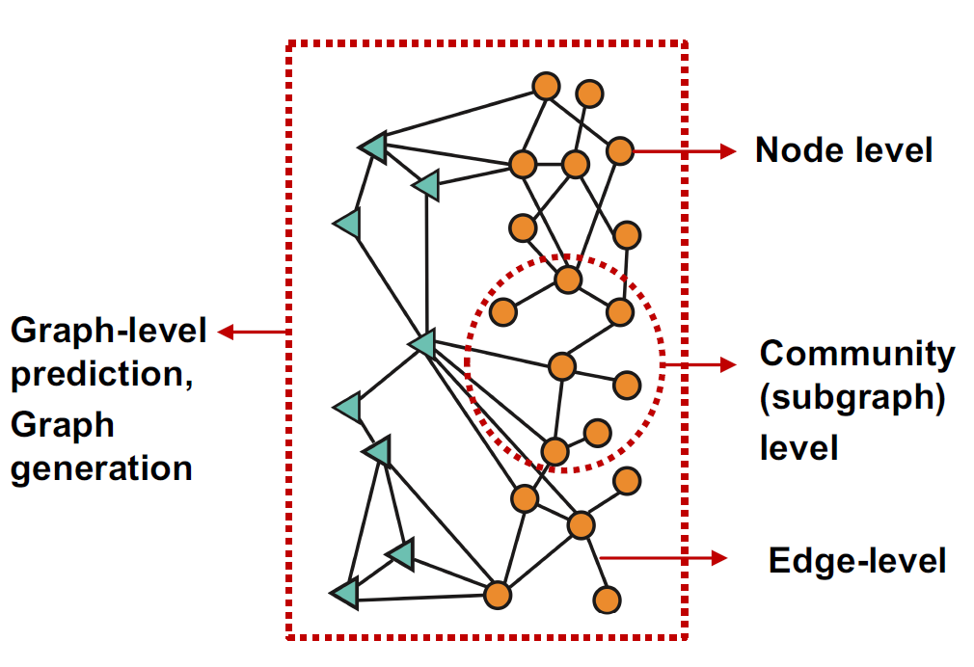
Different Types of Tasks
56

Slide 57
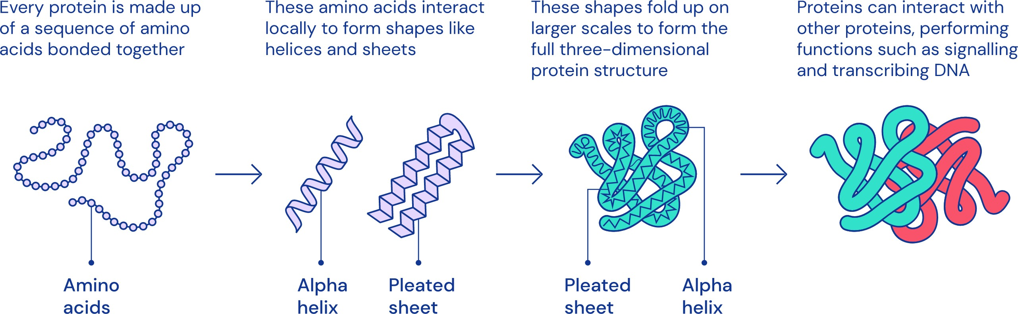
Protein Folding Problem
Computationally predict a protein’s 3D structure based solely on its amino acid sequence
57

Slide 58
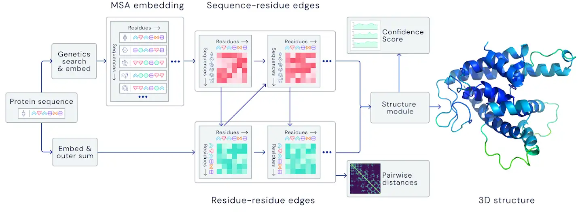
AlphaFold
Image credit: DeepMind
Spatial graph
58

Slide 59
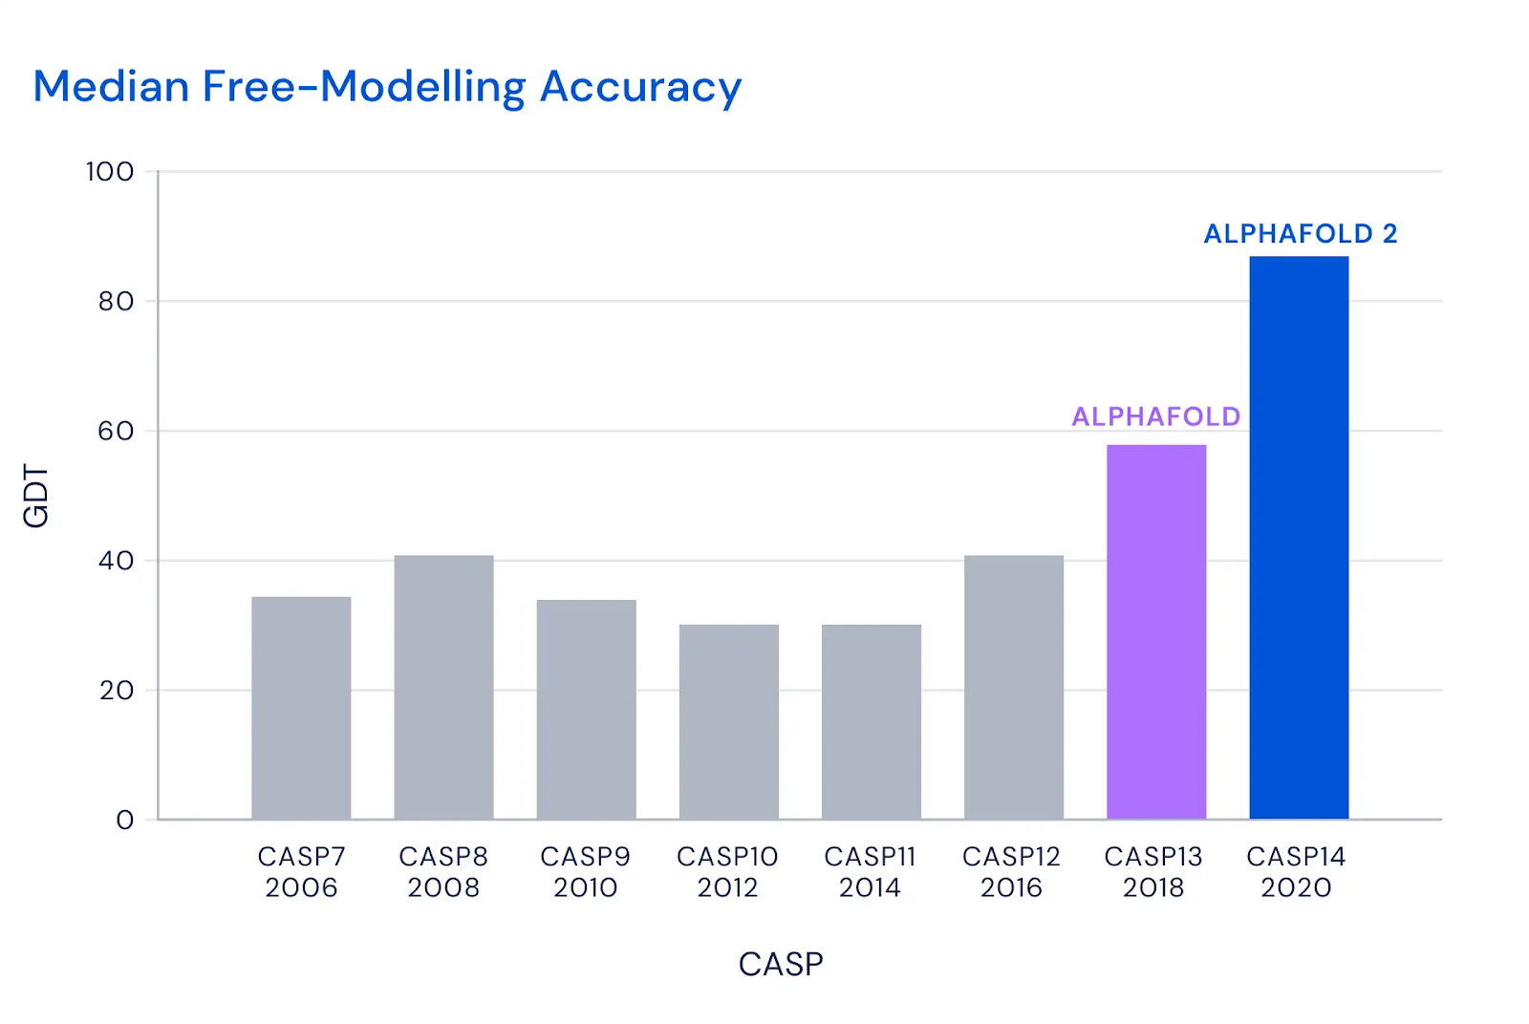
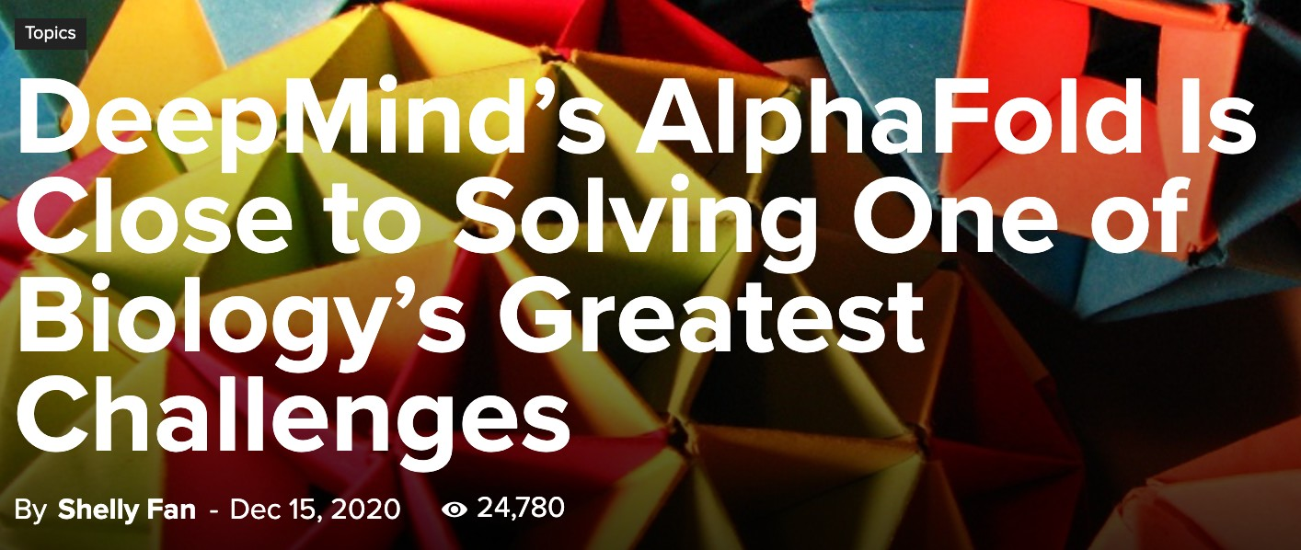
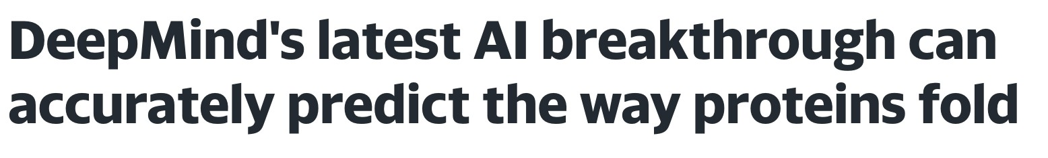



AlphaFold: Impact
Image credit: SingularityHub
Image credit: DeepMind
59

Slide 60



Example 2: Drug Side Effects
Polypharmacy is the use of drug combinations and is commonly used for treating complex and terminal diseases.
46% of people ages 70-79 take more than 5 drugs
Many patients take more than 20 drugs to treat heart disease, depression, insomnia, etc.
Despite its effectiveness in many cases, it poses high risks of adverse side effects.
30%
prob.
65%
prob.
,
60

Slide 61
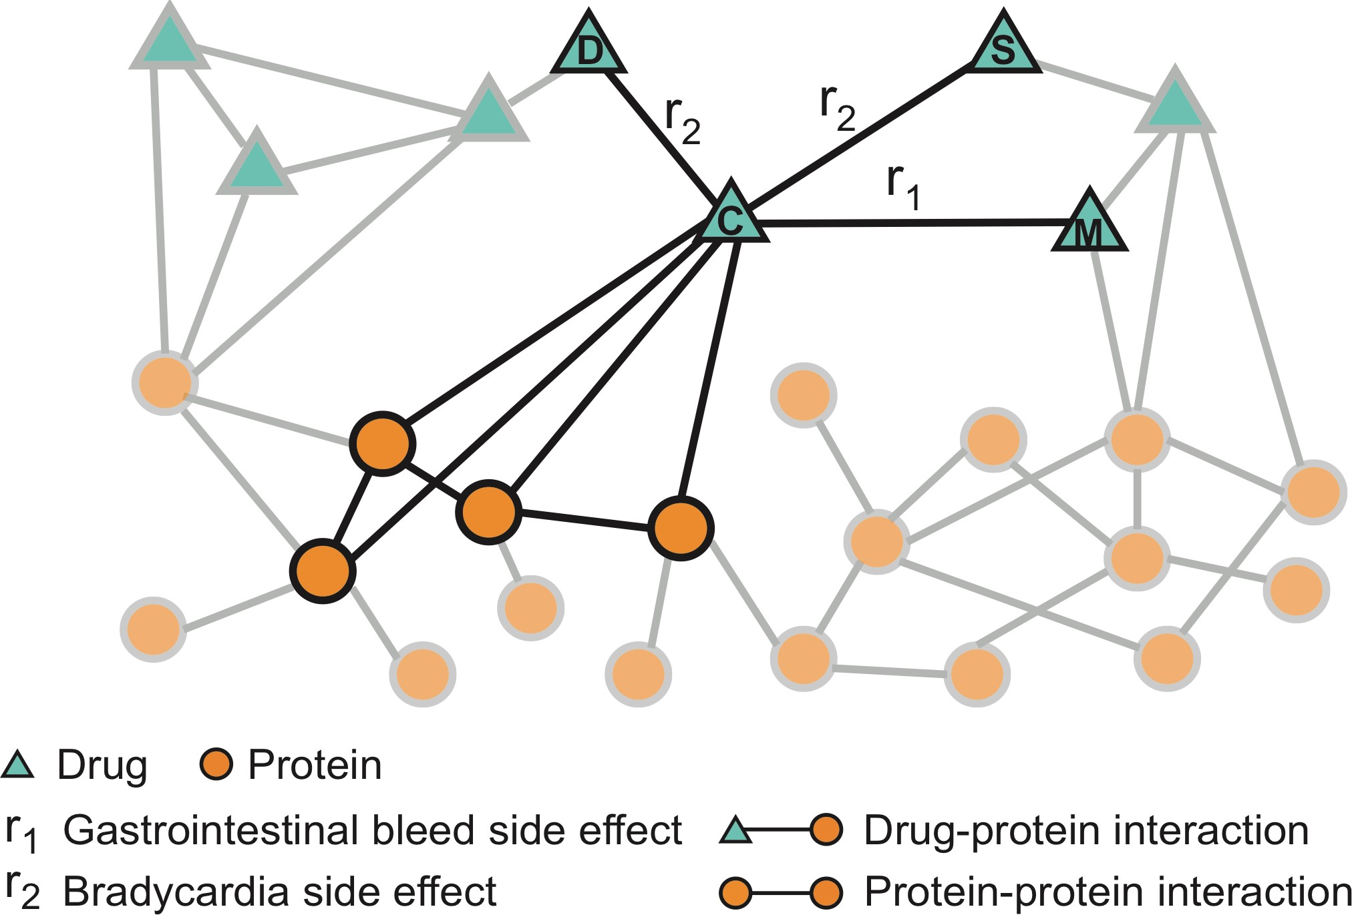
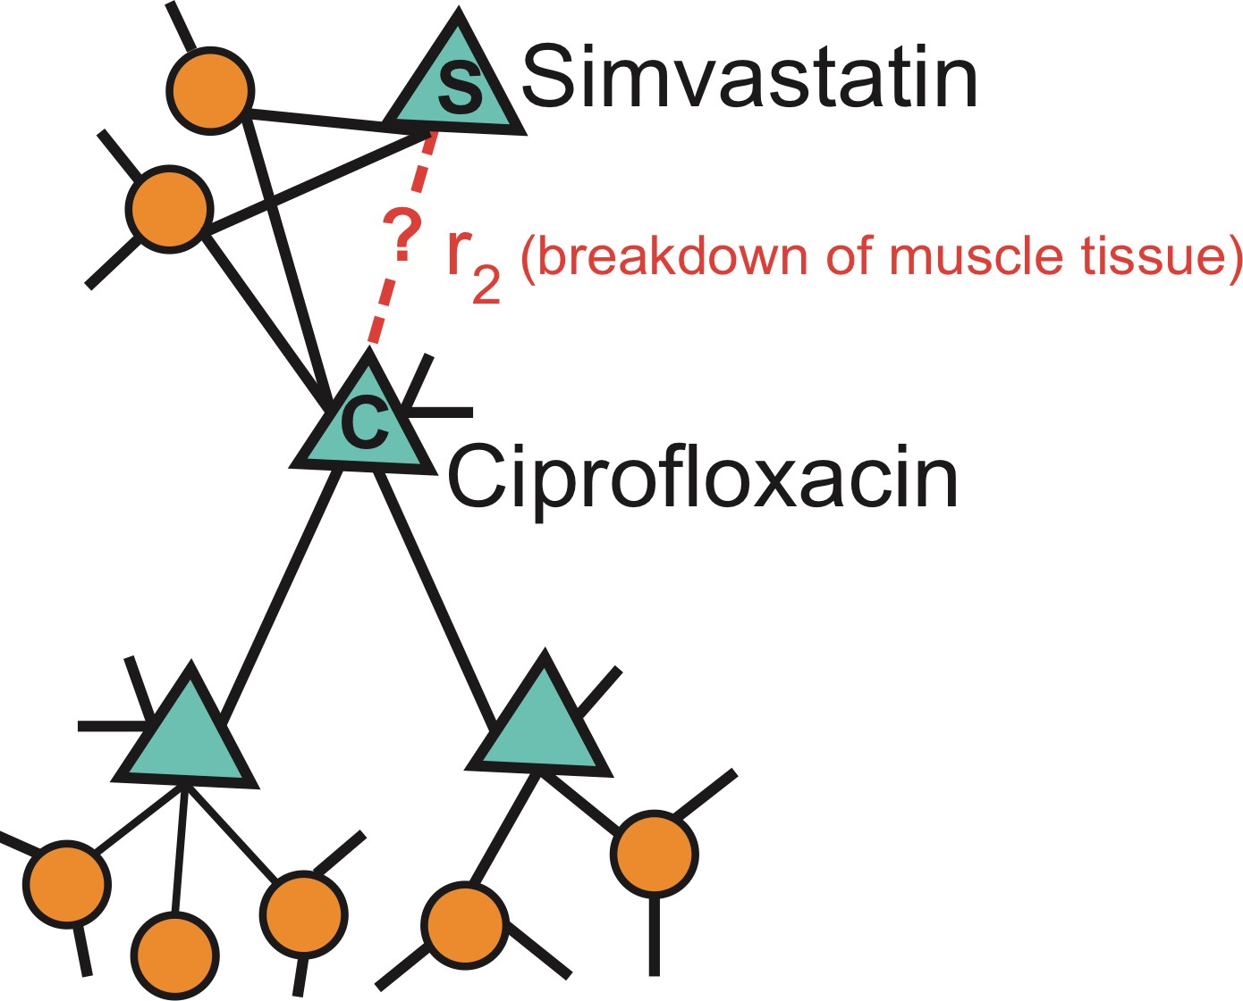
Zitnik et al., Modeling Polypharmacy Side Effects with Graph Convolutional Networks, Bioinformatics 2018
Link Prediction: Biomedical Graph
Nodes: Drugs & Proteins
Edges: Interactions
Query: How likely will Simvastatin and Ciprofloxacin, when taken together, break down muscle tissue?
61

Slide 62
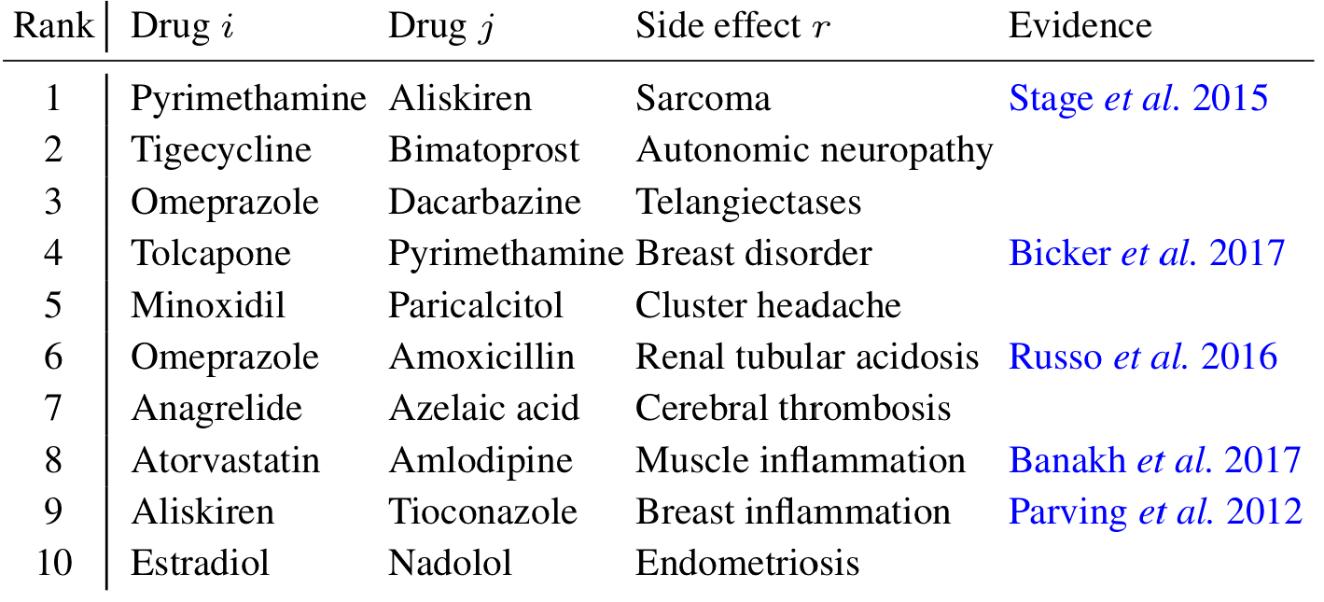
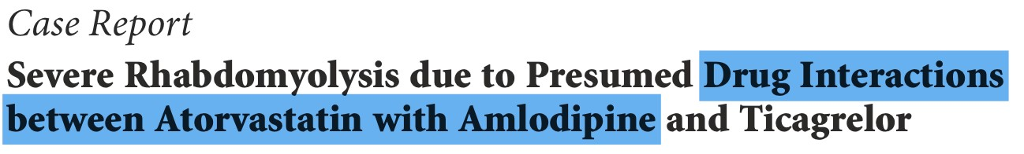
Zitnik et al., Modeling Polypharmacy Side Effects with Graph Convolutional Networks, Bioinformatics 2018
Link Prediction: Biomedical Graph
Drug c
Drug d
Evidence found
Acknowledgement: Jure Leskovec, Stanford University
62

